Slide 1
Human-Computer Interaction
paradigms
Md. Fazlul Karim Patwary
Associate Professor, IIT, JU

Slide 2
Why study paradigms?
Concerns
  how can an interactive system be developed to ensure its usability?
  how can the usability of an interactive system be demonstrated or measured?
History of interactive system design provides paradigms for usable designs

Slide 3
What are Paradigms?
Predominant theoretical frameworks or scientific world views
  e.g., Aristotelian, Newtonian, Einsteinian (relativistic) paradigms in physics
Understanding HCI history is largely about understanding a series of paradigm shifts
  Not all listed here are necessarily “paradigm” shifts, but are at least candidates
  History will judge which are true shifts

Slide 4
Paradigms of interaction
New computing technologies arrive, creating a new perception of the human—computer relationship.
We can trace some of these shifts in the history of interactive technologies.

Slide 5

Initial paradigm
Batch processing
Batch processing is the processing transactions in a group or batch. No user interaction is required once batch processing is underway.
This differentiates batch processing from transaction processing, which involves processing transactions one at a time and requires user interaction. While batch processing can be carried out at any time i.e. iddle time.
Impersonal computing

Slide 6
Paradigm Shifts
Interactive computing
Batch processing
Time-sharing
In data processing, method of operation in which multiple users with different programs interact nearly simultaneously with the central processing unit of a large-scale digital computer.

Slide 7
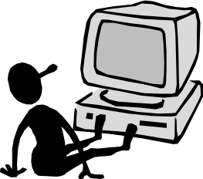
Paradigm Shifts
Batch processing
Timesharing
Networking
@#$% !
???
Community computing

Slide 8
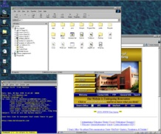
Paradigm Shifts
Batch processing
Timesharing
Networking
Graphical displays
Move this file here,
and copy this to there.
C…P… filename
dot star… or was
it R…M?
% foo.bar
ABORT
dumby!!!
Direct manipulation

Slide 9
Paradigm Shifts
Batch processing
Timesharing
Networking
Graphical display
Microprocessor
Personal computing

Slide 10
Paradigm Shifts
Batch processing
Timesharing
Networking
Graphical display
Microprocessor
WWW
Global information

Slide 11

Paradigm Shifts
Batch processing
Timesharing
Networking
Graphical display
Microprocessor
WWW
Ubiquitous Computing
A symbiosis of physical and electronic worlds in service of everyday activities.
Notes:
Ubiquitous computing is a paradigm in which the processing of information is linked with each activity or object as encountered.
It involves connecting electronic devices, including embedding microprocessors to communicate information.

Slide 12
Sensor-based and Context-aware Interaction
Humans are good at recognizing the “context” of a situation and reacting appropriately
Automatically sensing physical phenomena (e.g., light, temp, location, identity) becoming easier
How can we go from sensed physical measures to interactions that behave as if made “aware” of the surroundings?

